Slide 1


Merch Metrics
Presented by
Ads Merch Analytics
May 2022

Slide 2
Merch Funnel Metrics
(go/merchfunnel)
Metric No. | Metric Name
1 | Server-side Triggered Placement-level Impression
2 | Server-side Delivered Placement-level Impression
3 | Server-side Algo Return Rate (=2/1)
4 | Server-side Delivered Item-level Impression
5 | Server-Side Returned Item # per Placement (=4/2)
6 | Merch Clicks
7 | Merch Clicks per 1K Server-Side Delivered Placement Impression (“Merch CTR” = 6/2)
8 | Merch-Initiated Purchases ("Mi-Transaction") or Bought Item
9 | Merch-Initiated Purchase Per Click (=8/6)
10 | Merch-Initiated GMB ("MiGMB")
11 | Average Bought Price (=10/8)
12 | Merch (Attributed) PLS GMB
13 | Share of Merch PLS GMB (=12/10)
14 | Merch (Attributed) PLS Rev
15 | Merch (Attributed) PLS Sold Ad Rate (=14/12)
Functionality (Home Splice)
In progress:
Nori tracking
rendered impressions
rendered surface rate
Viewport tracking (link to validation)
Actual impressions on buyer side
Actual CTR & dwell time
Engagement
Conversion
&
Attribution
PLS
Attribution

Slide 3
2023 Ads CPS Metrics - Merch related
Monthly CPS tracker; Nous dashboard; Merch GMB dashboard (go/merchgmb)
Ads Initiative-level (4 in total):
Relevance of promoted vs. organic listings on merch (human judgment)
Baseline 0.89; Goal 0.85
Ads revenue penetration (Ads revenue as of Site GMB)
Merch PLS revenue/Site GMB
Ads Pillar-level (3 pillars, 12 metrics):
MiGMB/Site GMB
Baseline 12%; Goal 12%

Slide 4
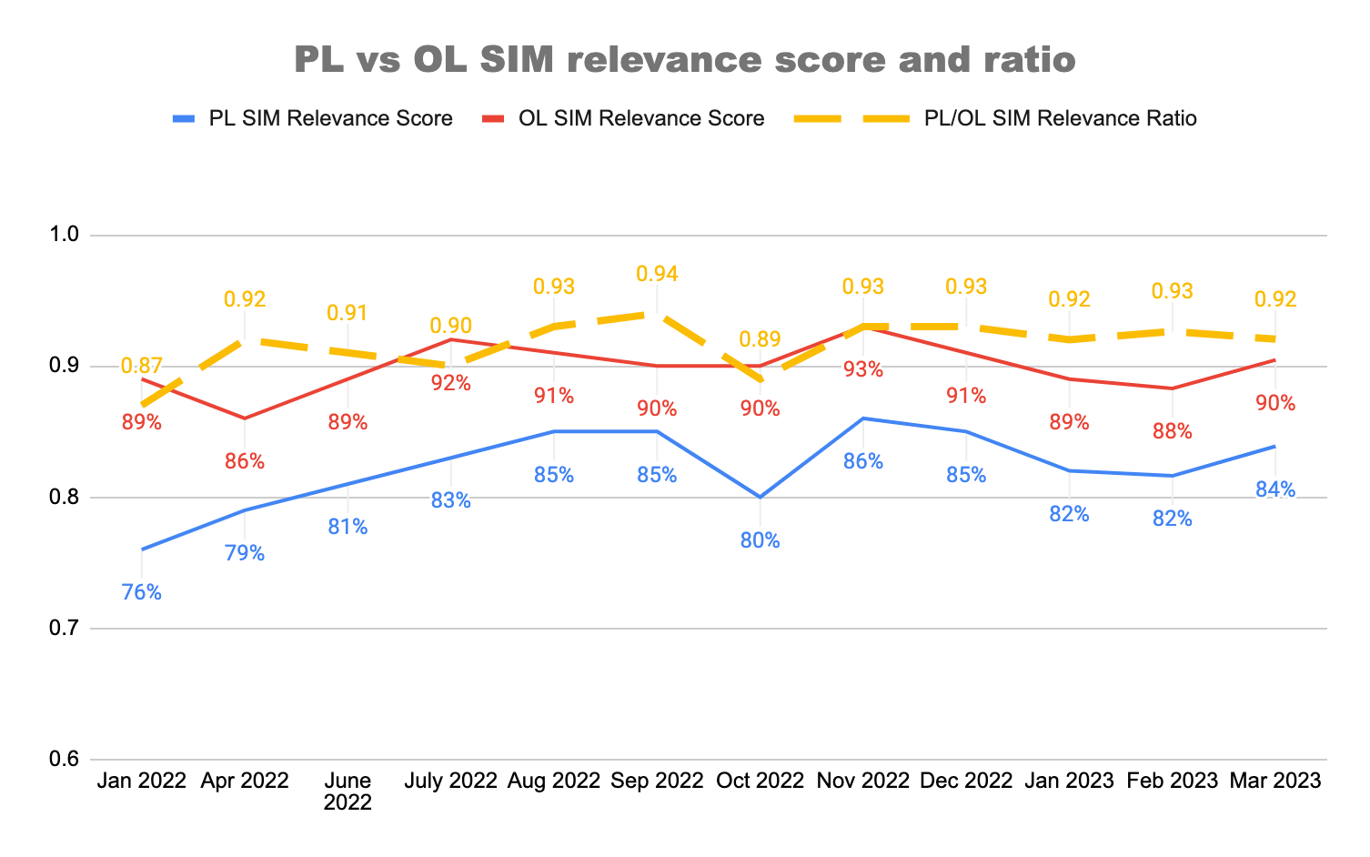
Merch relevance has improved over time due to product launches
Link to data source
Link to the methodology

Slide 5
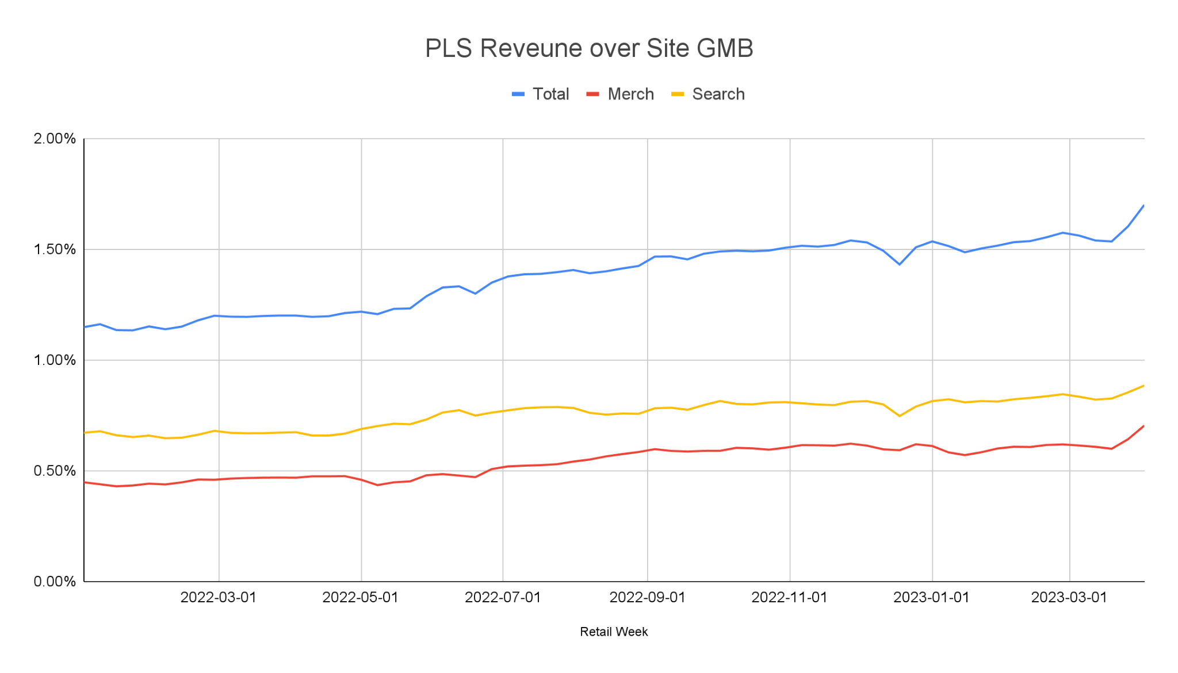
Merch PLS Revenue Penetration increased from 0.44% in Jan 2022 to 0.61% in March 2023, then further boosted to 0.70% by Halo.
2023 Merch PL Rev tracker
Changed to Halo Attribution on 03/30/2023
(+10%)
Changed to 2.0 charging on 06/01/2022
(+8%)
Headwind from VI* on 5/03/2022 (-2.4%)
0.70%
0.44%
0.61%
* moving “About this Item” on Top in Native (launched on 5/03/2022): -2.4% impact on total PLS Rev (-10% on Merch PL Rev)
Notes:
Native: https://docs.google.com/presentation/d/1ifR62vjxKka3t70bbFuVbtbM0Cdth8srfDsJZXJm4EA/edit#slide=id.g12917356e0f_15_17
2.0: https://docs.google.com/presentation/d/1ifR62vjxKka3t70bbFuVbtbM0Cdth8srfDsJZXJm4EA/edit#slide=id.g131b51d479a_1_7

Slide 6
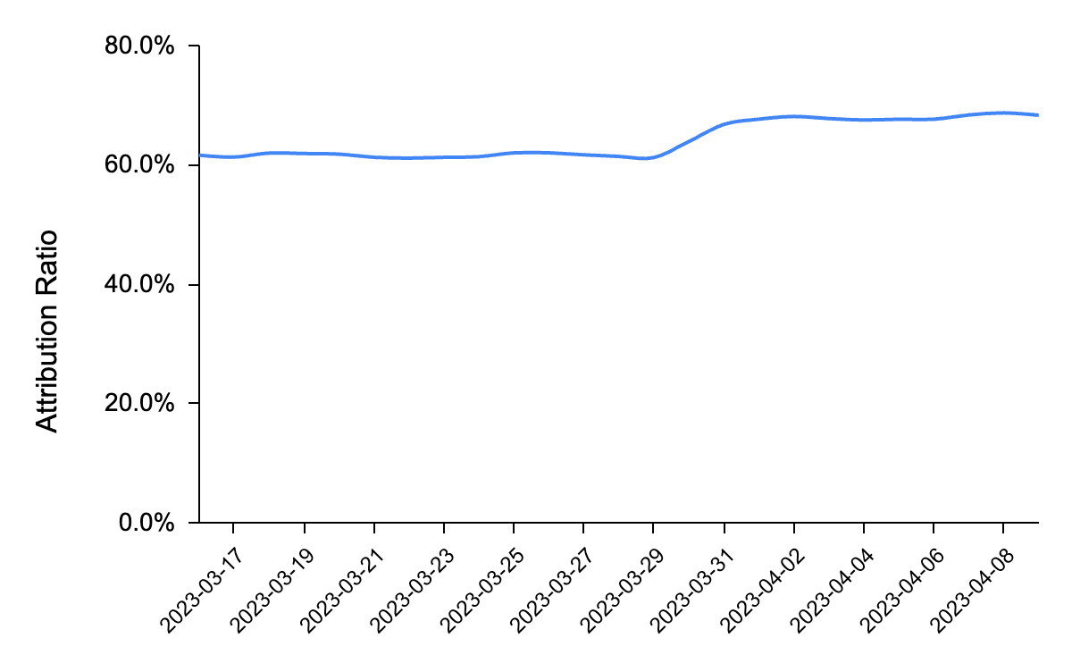
Halo Attribution
Halo Attribution continues to drive incremental Revenue of $284K* daily
Key Takeaways (based on 04/03-04/09):
Attribution Ratio holding at 68% post launch (04/03-04/09, compared to 61.6% prior to launch); expected to mature by end of April
Daily avg. Incremental PL Revenue is $282K
PL advanced revenue from “Add to Watch” clicks continues at $2.4K daily
# | Event Type | Purchased Item Clicked/ATW | Last Click | Daily PL GMV | Daily PL Revenue
Base Line | Click | Direct | PLS | $46.05M | $2,832,752
Incremental | Click | Direct | Dual: PLA/SFA | $0.17M | $12,232
 |  | Halo Item | Halo PLS | $4.33M | $234,368
 |  |  | Dual: PLA/SFA | $0.15M | $11,418
 | Add to Watch | Direct | PLS | $0.32M | $19,360
 |  |  | Dual: PLA/SFA | $0.00M | $39
 |  | Halo Item | Halo PLS | $0.04M | $2,057
 |  |  | Dual: PLA/SFA | $0.00M | $61
 |  | Direct (PLA) | PLA/SFA | - | $2,347
Grand Total |  |  |  | $51.06M | $3,114,633
PLS
Halo Attribution Launch - 03/30
68%
61.6%
PLA
Dashboard
Incremental PL Revenue: $284K
PLS Rev = $282K (vs. $222K in budget**)
PLA Rev = $2.4K
*Note: Data based on daily average of Global Fixed Priced Listing’s Transactions between 04/03-04/09
** Budget incorporated a 20% haircut on sizing for Seller Reaction. Post launch, we have not seen any significant seller reaction yet

Slide 7
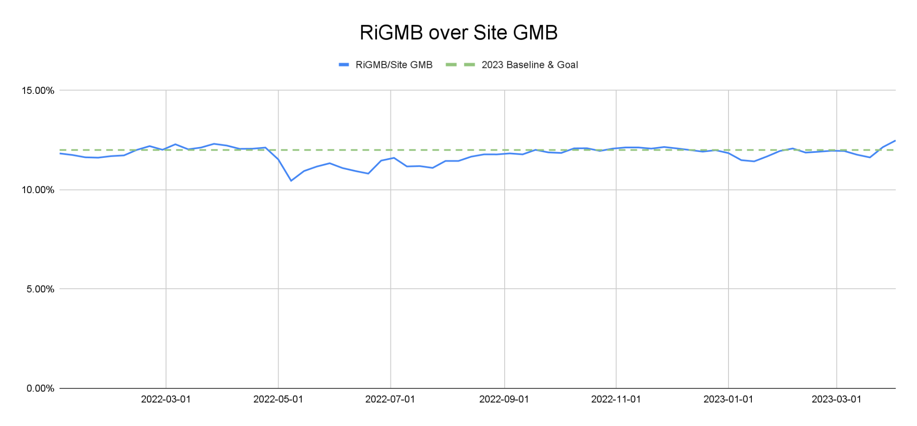
MiGMB over Site GMB was stable ~12% this year due to several headwinds, and recently increased to 12.5% driven by Halo.
2023 MiGMB tracker
Next question: how could Merch team drive GMB growth?
Headwind from VI on 5/03/2022
12.0%
12.5%
11%
Changed to Halo Attribution on 03/30/2023
Notes:
https://docs.google.com/spreadsheets/d/1pZvOp5BqM6E3I53mvyb41uhrN-lU1Ojzs_n02YCEMNk/edit#gid=338059142

Slide 8
Appendix

Slide 9
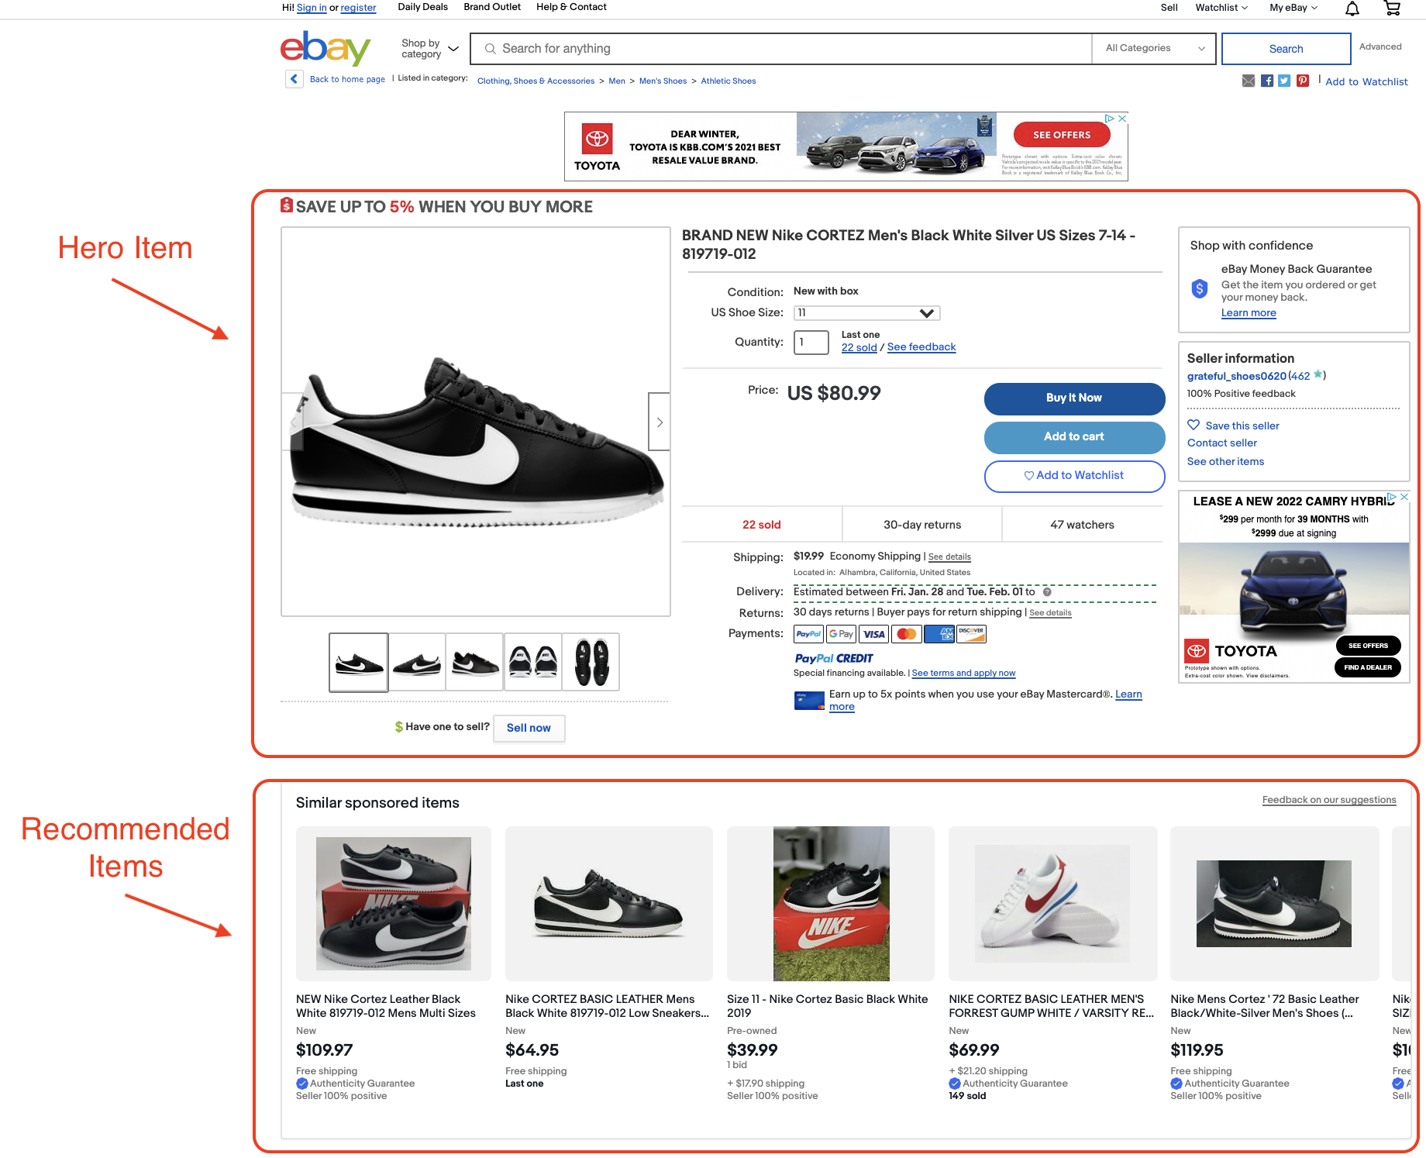
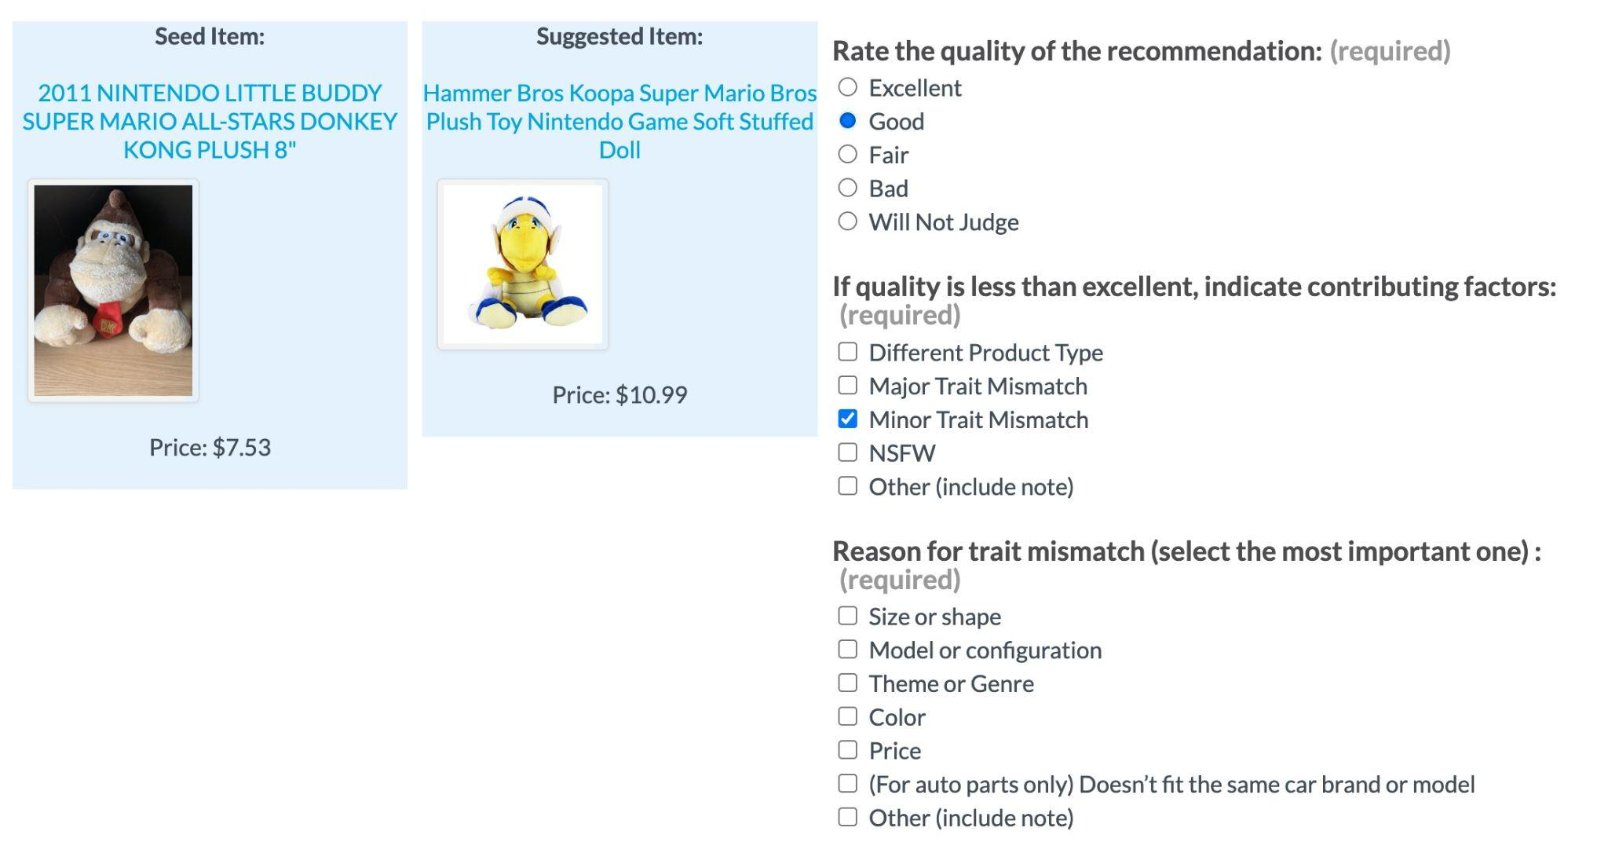
Relevance of promoted vs. organic listings on merch (human judgment)
Item Sampling
Human Judgment
Result Analysis
Merch relevance score in Feb 2023
 | PL SIM relevance share | OL SIM relevance share | PL/OL SIM relevance ratio
US | 81% | 88% | 0.92
UK | 83% | 89% | 0.93
DE | 81% | 87% | 0.93
SITE AVG | 82% | 88% | 0.93
* Analysis on Merch relevance score in 2023
Human judges assign a quality score of “Excellent”, “Good”, “Fair” or “Bad” to each recommended item based on the item titles, images and prices
If the quality is less than “Excellent”, they will select the reason for the quality downgrade and the most important trait mismatch (size, shape, model, etc.)
Calculate the the relevance share for each site and PL/OL as the share of “Excellent” and “Good” recommendations
Calculate the ratio of PL over OL SIM relevance share for each site, and compute the average ratio across sites to get the Merch relevance score
In each month, randomly select 10K seed-recommended item pairs within top 5 rank from the sponsored (PL) and organic (OL) SIM modules in US/UK/DE sites
Notes:
https://docs.google.com/presentation/d/18QpwtygDSM9ZLJpLzJwnN_gdjj-lGLynoGdaXGFY0mI/edit#slide=id.g1f19b635220_0_430

Slide 10
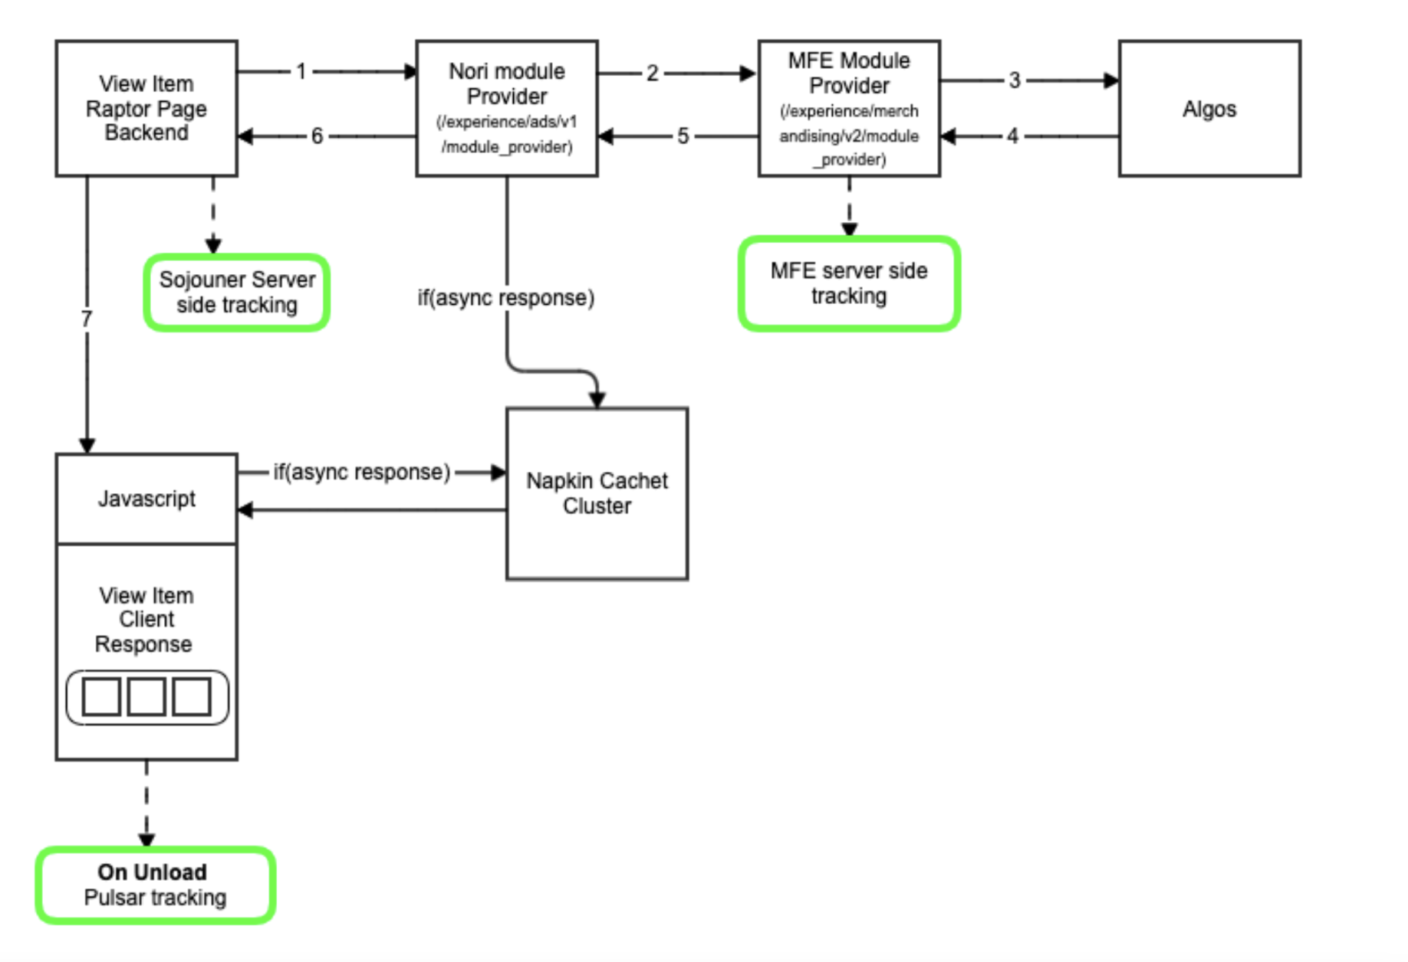
VIM migration
Render Ready (RNRY)
/ Homesplice
/ Cache

